Slide 1
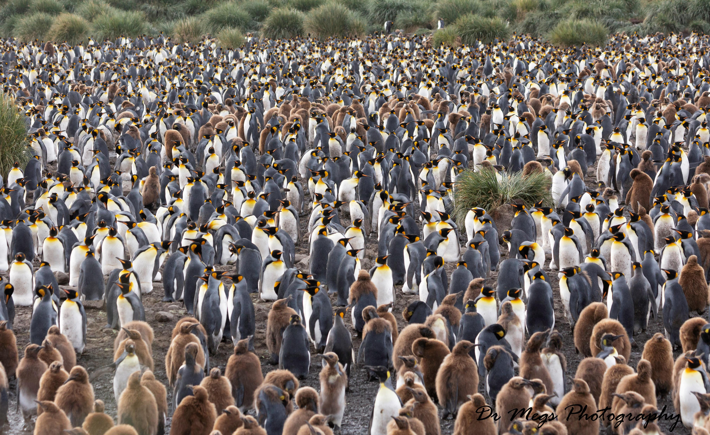
Risk of Avian Influenza in Antarctica
Antarctic Wildlife Health Network

Slide 2
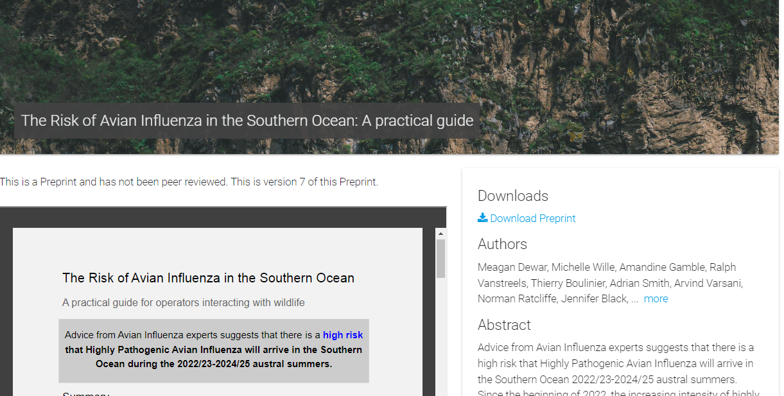
Risk Assessment: A Practical Guide

Slide 3
Expanded Risk Assessment
In response to rapidly increasing spread of HPAI throughout South America and requests for further information and guidance
New Document includes;
Extensive background information on Avian Influenza, history of HPAI in seabirds and Antarctica
Comprehensive risk assessment by region and species
Expanded recommendations
Detailed Guidelines

Slide 4
Species Risk Assessment
Assessed the susceptibility of different wildlife groups to HPAI outbreak
3 variable chosen to identify risk for each group
Each variable ranked out of 5
1 = low
5 = high
Calculate Species Vulnerability Score

Slide 5
Variables
Known Susceptibility
Is the group capable of being infected by HPAI?
Risk Behaviours
Does the group present behaviours that might put it at an increased risk of exposure/transmission of HPAI?
Population Connectivity
Do the individuals of this group frequently interact with those of other island groups, continents or oceans?

Slide 6
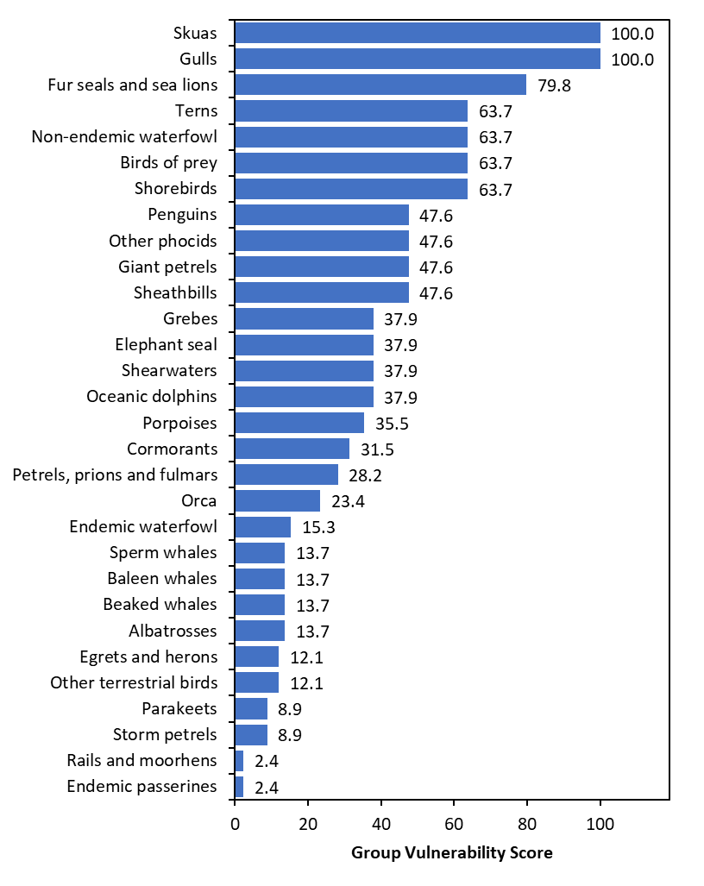
Risk Assessment

Slide 7
Regional Risk Assessment

Slide 8
Variables
Vulnerability Score
Proximity & wildlife Exchange
Reservoir Hosts
Human Presence
Immediate Risk Score
Variables above plus distance to current outbreaks

Slide 9
Area Vulnerability Score

Slide 10
Immediate Risk

Slide 11
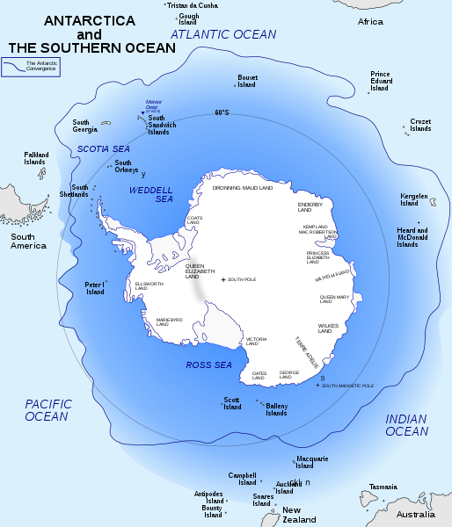
Expected Pathways
South America
Falkland Islands
South Georgia
South Sandwich Island
Antarctic Peninsula

Slide 12
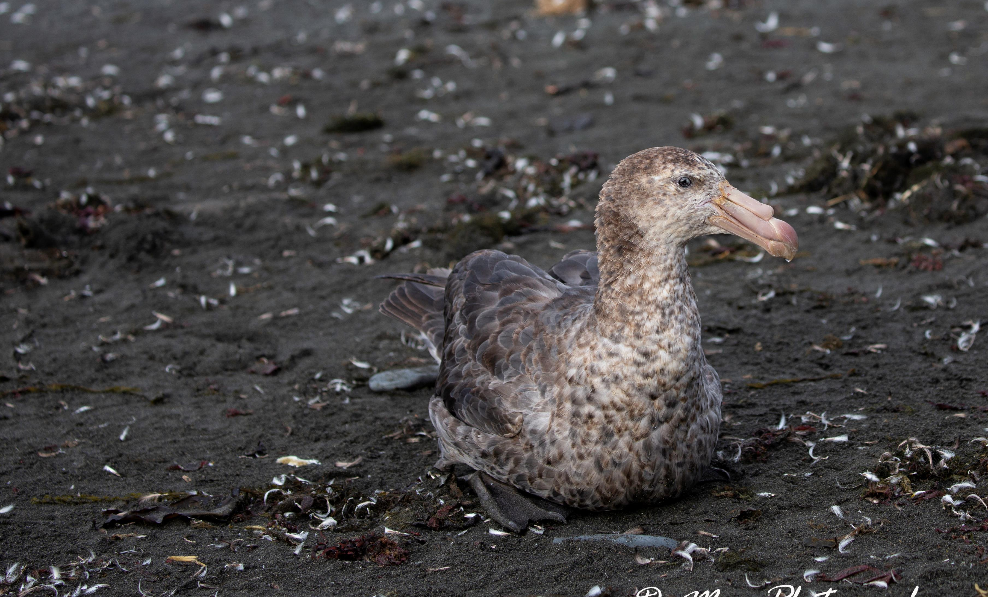
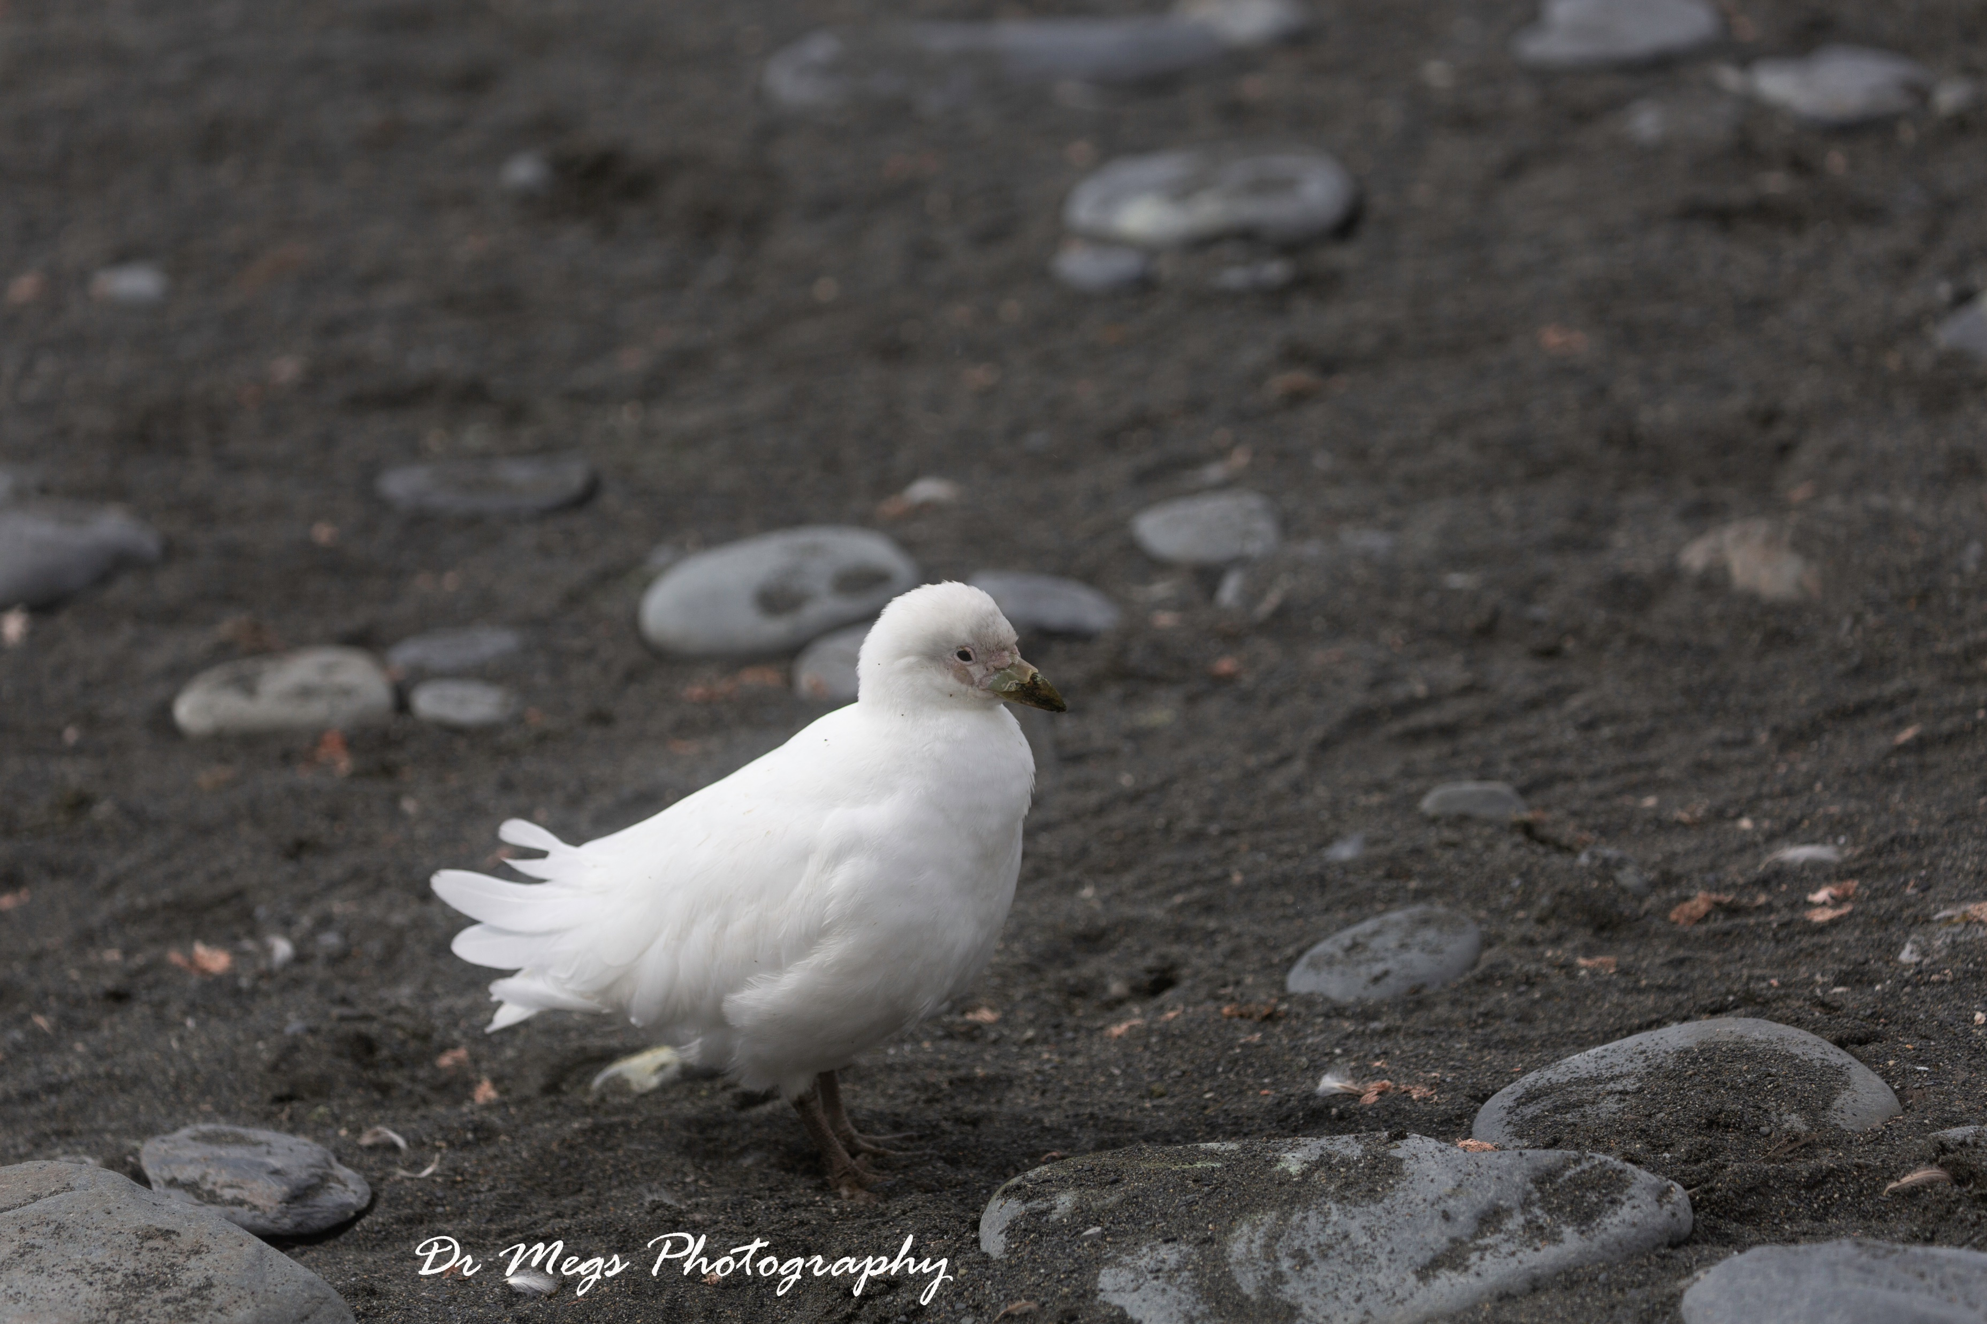
Potential Vector and Spreader Species
Kelp Gulls
Brown and South Polar Skua
Giant Petrel
Arctic Terns
Waders/Ducks in sub-Antarctic
Sheathbills
Spreaders
Prospecting Juveniles

Slide 13
Recommendations – Biosecurity
Before and After visiting colony
Clean footwear, clothing and equipment of any solid material
Spray with Viraclean, Virkon or F10.
Follow ATCM Guidelines on visitation to wildlife colonies,
Only permitted scientists should enter colony
Keep distance from wildlife
Avoid sitting down on the ground near wildlife colonies
Do not enter colonies with unusual mortality or behaviour
Do not touch sick, dying or dead animals unless permitted to

Slide 14
Recommendations – Surveillance
Surveillance prior to outbreaks (dependant of capabilities)
Visual Surveys
Scan Colony for signs of unusual behaviour and mortality
Drone Surveys (only trained, licenced and permitted operators)
Fly over colony taking video recording of colony
Look for signs of unusual behaviour and mortality
Virus Screening
Non-invasive collection of faecal samples and environmental samples
Genetic screening via PCR/qPCR for virus
Antibody Testing (Ethics required, only trained personnel)
Collection of Plasma for detection of past virus infection (LPAI)

Slide 15
Suspected Events
Suspicious, neurological behaviours
Unusual Mortality
Dependant on species
Minimum cluster of 5+ dead birds, especially adults
Trigger Action Plan

Slide 16
Recommendations – Responding to Event
Record details of colony, including
Species affected
Percentage of infected birds
Percentage of deceased
Take video/photos of colony
GPS location
Report sighting to relevant authority and enact Avian Influenza Response Plan
Close site and surrounding area to all non-essential personnel for the duration of the outbreak

Slide 17
Recommendations – Responding to Event
Remember this is class 3 pathogen
PPE
Appropriate PPE must be worn before entering a colony with suspected or confirmed HPAI
All personnel should be trained in PPE donning and removal

Slide 18
Recommendations – Sample Collection
If trained personnel are permitted to, collect samples
Ethics and Permits required
Samples collected direct from animals
Dependant on species
Sample collection will be dependant on testing process
Sample preservation
Certified Lab – Live virus
Genomic Testing – DNA/RNA Shield, RNALater

Slide 19
Recommendations – Other Monitoring
Recommended to monitor outbreak, preferably via visual surveys to prevent spread of virus
From a height using binoculars
Record spread/movement of virus in colony
Percentage of individuals affected
Via Drone Survey
Take video of colony
Record spread/movement of virus
Percentage of individuals affected

Slide 20
Recommendations –Active/Suspected Case Testing
Certified Laboratory Testing (Off-site)
Require import/export permits & Licences
Agreements must be in place before season begins
Specific collection requirements for preservation
Note importing/exporting class 3 pathogens and/or genomic material lots of restrictions

Slide 21
Recommendations –Active/Suspected Case Testing
On-site Testing
Trained personnel
Check Regulations with Govt – Class 3 pathogen requirements
PCR/qPCR – presence/absence
MinION – in depth genomic information
Samples stored in RNA preservation media
Recommend collection of samples for Genomic testing if applicable
Identification of
Variants
Origin and movement of virus

Slide 22
Recommendations – Biogeographical Response Plans
Establish joint and coordinated surveillance and response plan in different bioregions
Prevent overlap, over sampling of sites
Assist each other with surveillance, response and testing

