Slide 1
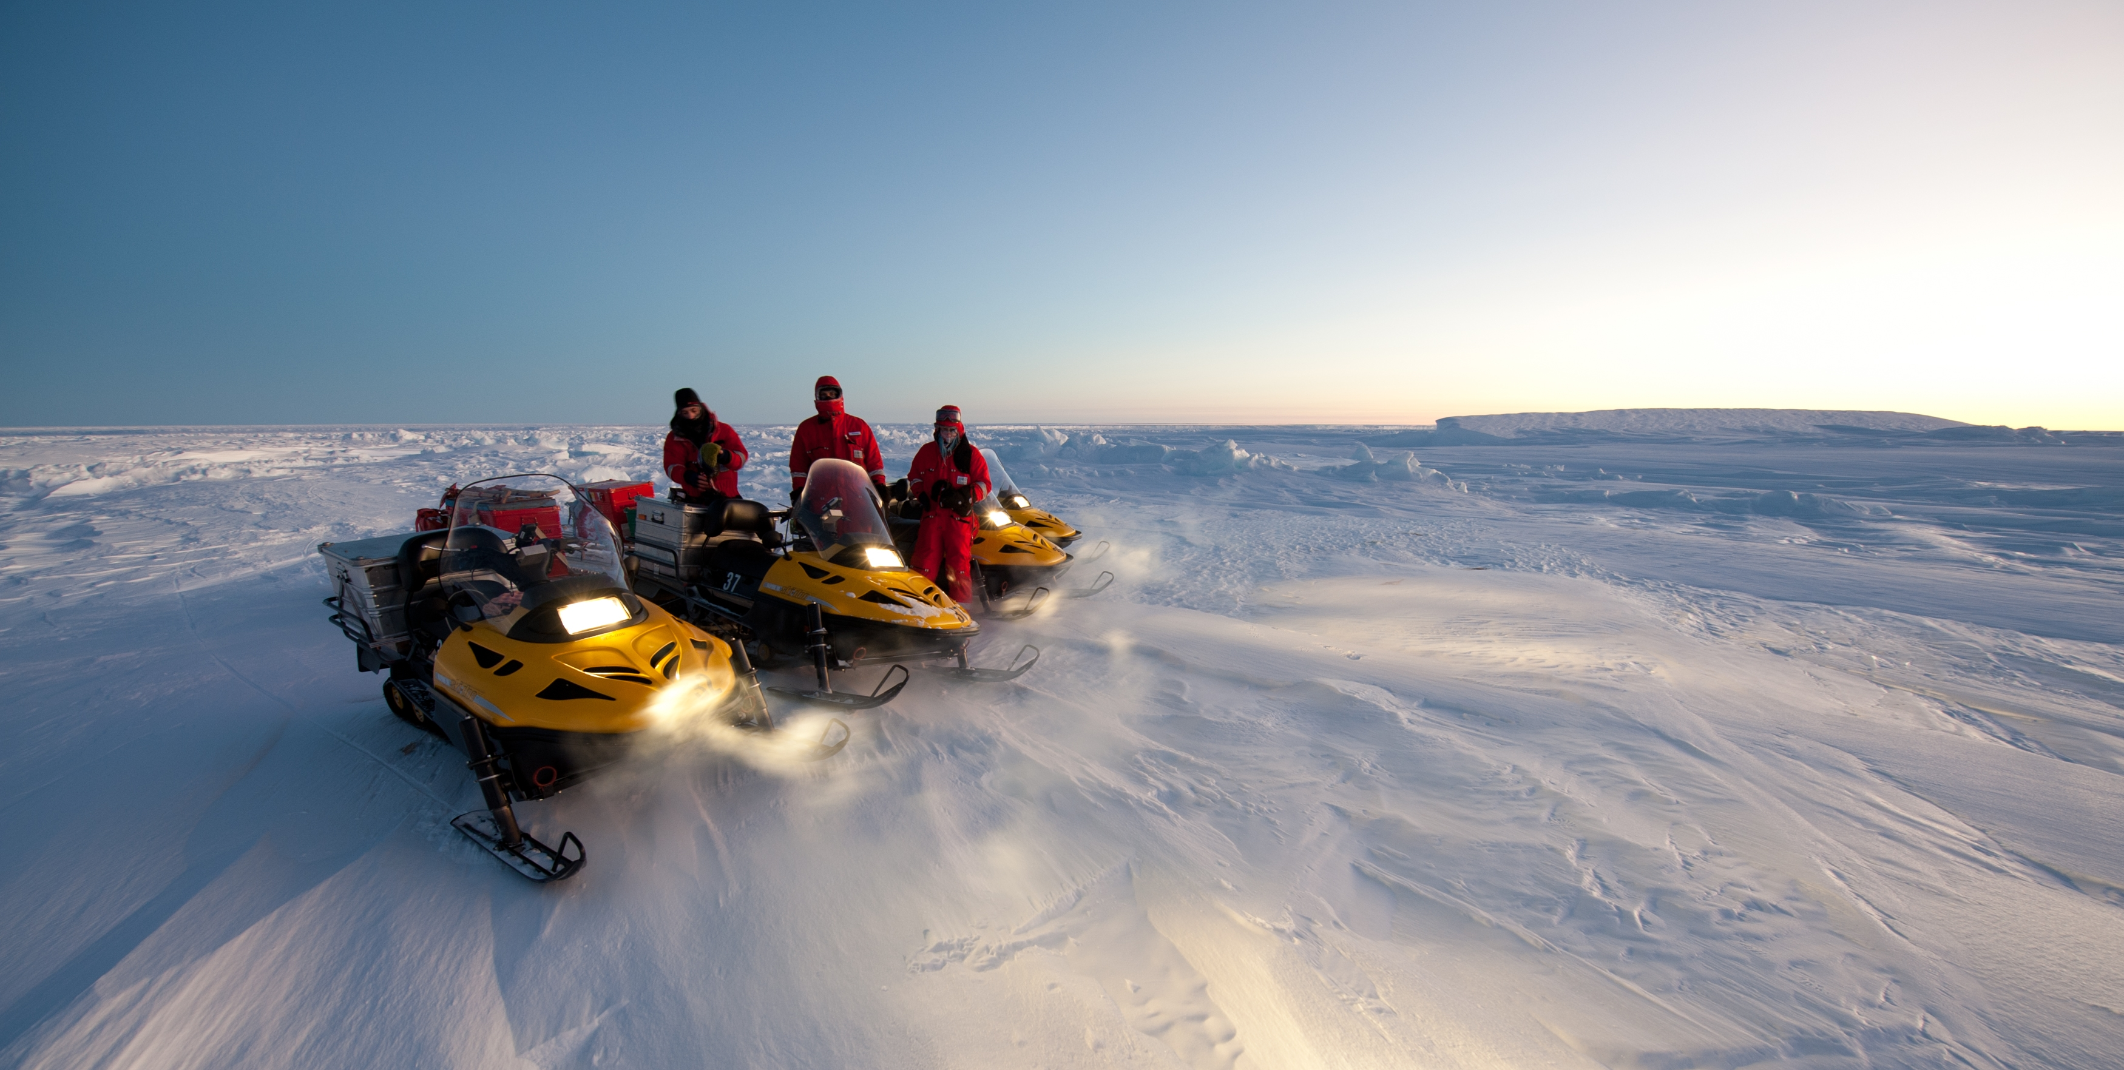
Arctic Frontiers 2019, Tromsø
Minimising plastic use and waste in polar research and logistics
Kirsi Latola
Chair, European Polar Board
Photo: Alfred Wegener Institute for Polar and Marine Research

Slide 2
Background
POLAR2018 workshop
Davos, June 2018
EPB Members, national programme managers, logistics managers, scientists, operators
Notes:
The EPB initiative began with a workshop during the POLAR2018 conference in Davos, Switzerland, in June 2018
The workshop brought together EPB Members, along with scientists, logistics managers, national programme managers, operators, and other experts
Discussed:
The impact of plastics on the environment and ecosystems
How to identify how much, what kind and for what plastic is used in polar research and logistics
Ways in which plastic use can be reduced
Ways to better manage disposal of plastics
Possible alternatives to plastics

Slide 3
Workshop
Plastic auditing
What types of plastics do we use?
What types of plastics do we use the most?
How much of single‐use plastic is used?
How can we reduce our use of single‐use plastics?
Difficult to quantify for large organisations
and programmes
Notes:
Workshop introduced the process of plastic auditing to participants – already completed in some organisations or programmes
Quantifying the plastic used and how it is disposed of is the first step
This is difficult for large organisations and programmes

Slide 4
Workshop breakout groups
Logistics (Packing, biosecurity, transport, etc.)
Scientific equipment and consumables (Lab and field)
Field equipment (Clothing, camping gear, food, safety, etc.)
Domestic (Catering, cleaning, medical, personal, etc.)
Notes:
Workshop divided into breakout groups to discuss plastic use in different areas of polar research and logistics
Logistics (Packing, biosecurity, transport, etc.)
Scientific equipment and consumables (Lab and field)
Field equipment (Clothing, camping gear, food, safety, etc.)
Domestic (Catering, cleaning, medical, personal, etc. at stations and on vessels)

Slide 5
Workshop
Whole life, from supply/procurement to use to disposal – including after removal from polar regions
All scales of operations and expeditions
Arctic and Antarctic, marine and terrestrial
Notes:
Workshop participants given guidance to help discussions

Slide 6
Workshop
Why plastic is used, justify? Benefits of plastic?
Where can plastic use/waste be easily be reduced?
Where is plastic use/waste difficult to reduce?
Safety, environmental protection and research quality cannot be compromised
Notes:
Questions to help guide workshop discussions
Emphasise that the benefits of plastic are not ignored – lightweight, cheap, sterilising, preserving samples, etc.
But these much be enough to justify the negative impacts

Slide 7
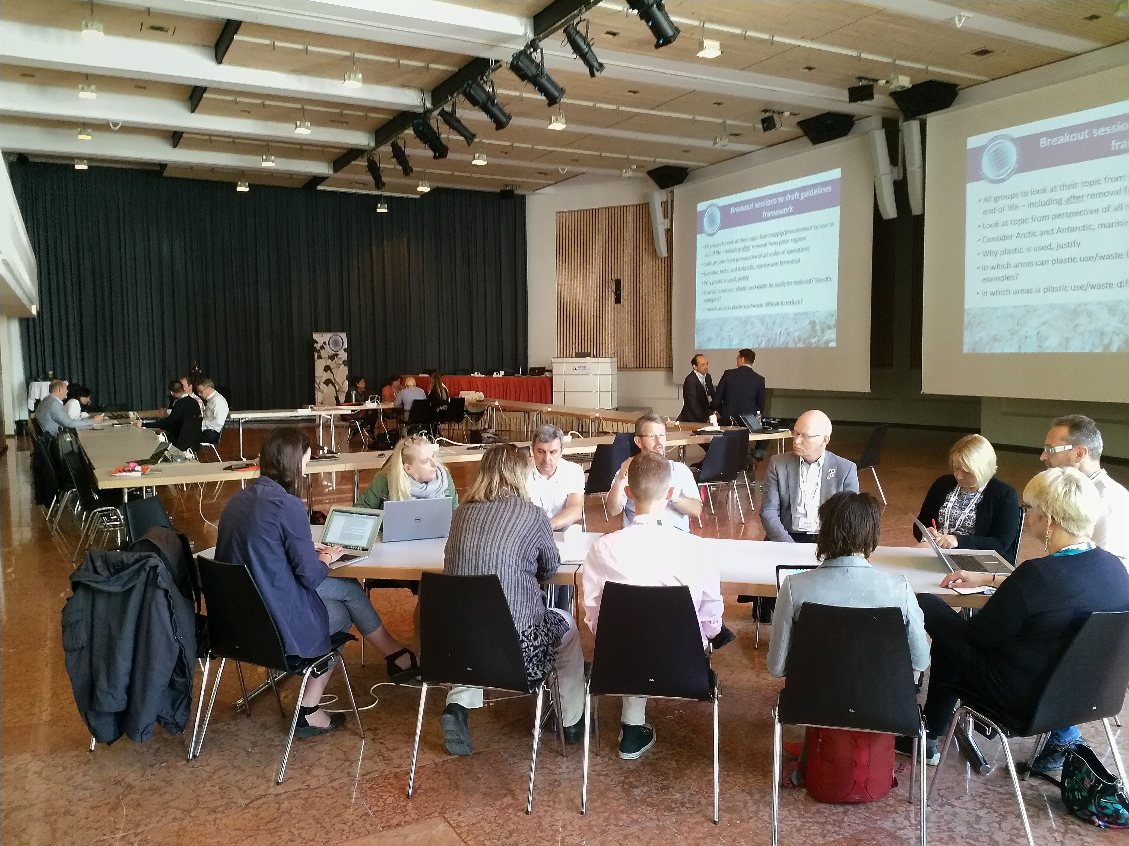
Workshop statement
Workshop statement available at www.europeanpolarboard.org
Notes:
A statement from workshop participants outlines their intent to explore opportunities to minimise plastic use and waste in their work in polar research and logistics.
The statement is available online at the EPB website
Recommendations were made by each workshop breakout group which are outlined in the coming slides.
Recommendations made by each breakout are often applicable to all areas of polar research and logistics

Slide 8
Recommendations: Logistics
Explore all opportunities to minimise and reuse packing material
The approach to use, type and handling of plastics should be based on their length of stay in the environment: quick, long or no return
Engage with certified recycling programs to properly dispose of plastics after their removal from the polar regions
Add regulation of plastics to the Antarctic Treaty

Slide 9
Recommendations: Scientific
Equipment and Consumables
Clean up and disposal of plastics integrated into project plans
Increase awareness of the need for plastics waste mitigation among field scientists and staff
Tagging and barcoding of equipment to help tracking, retrieval and identifying sources of plastic
Minimise wrapping and packaging taken to the field, unpacking guidelines
It will not be possible to eliminate plastics – but alternatives need to be investigated

Slide 10
Recommendations:
Field Equipment
Use bulk packaging to reduce plastic components
Explore alternative materials and more resistant plastics resistant to degradation (cold, UV radiation, wind)
Filter microplastics and fibres from grey water
Colour-coding system to distinguish between low and high-risk plastics and aid decisions for procurement
Engage with industry and manufacturers to improve designs and find alternative materials

Slide 11
Recommendations: Domestic
Reduce plastic packaging
Bulk packaging of foods and cleaning supplies
Alternative packaging materials (metal, linen, glass, wax coating)
Using locally produced and procured products where possible and appropriate
Dehydrated foods
Avoid single-use and individually wrapped items
Ban cosmetics with microbeads at stations and on vessels
Increase awareness in order to change personal behaviour of scientists and staff
Notes:
Products with microbeads already banned by some national polar programmes – including the US Antarctic Program
Local procurement must not negatively impact local communities with already limited supplies – e.g. example of team of scientists stripping a small local supermarket bare in Greenland.

Slide 12
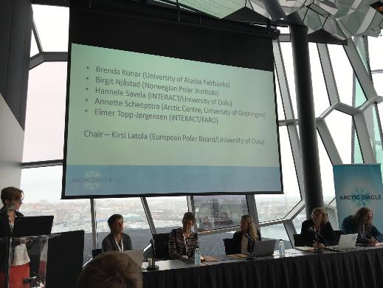
Minimising the footprint
of Arctic Research
Joint EPB-INTERACT session at Arctic Circle Assembly 2018, Reykjavik
Environmental impacts, including plastics, and social impacts
Antarctic experience in
Arctic context
Report available: www.europeanpolarboard.org
Notes:
Following the workshop, the EPB and INTERACT held a joint session at the 2018 Arctic Circle Assembly in Reykjavik.
Arctic focus, but including lessons learnt from Antarctic experiences.
Discussion of all environmental impacts of Arctic research, including plastics, and social impacts (positive and negative) on indigenous and local Arctic communities.
A report from the session is available at the EPB website.
Discussions from the sessions build on the workshop outcomes and develop the EPB initiative.

Slide 13
EPB Action Group
Action Group on Environmental Impacts of Polar Research and Logistics
Established at EPB Autumn Plenary Meeting in November 2018
Developing best practice guidelines for EPB Members and others
Cooperating with partner organisations
Notes:
In order to take forward the outcomes of the EPB plastics workshop in Davos and the EPB-INTERACT session in Reykjavik, the EPB Action Group on Environmental Impacts of Polar Research and Logistics was formed at the EPB’s Autumn Plenary Meeting in November 2018 in Madrid
Initiative has expanded to work towards minimising all the environmental impacts of polar research and logistics, not only plastics. Plastics remain an important focus of this work.

Slide 14
Next steps
Action Group will build on outcomes of workshops and sessions
Developing best practice guidelines for programme managers, operators, infrastructure managers, scientists and staff
Initiative focused on all environmental impacts of polar research and logistics – not only plastics
Collaboration with partner organisations [including INTERACT, FARO, COMNAP]
Notes:
The group will take forward the recommendations to develop best practice guidelines for EPB Members and others to help minimise the environmental impact of their work in the Arctic and Antarctic.
Practical guidelines are to follow a format similar to the “Aliens in Antarctica”/”Don’t pack a pest” guidelines for avoiding the introduction of invasive species to Antarctica.
Working closely with partner organisations, including INTERACT, FARO, COMNAP, EU-PolarNet and others.
[The EPB is open to those wishing to contribute to this work]

Slide 15
Questions?
Further information:
@EuPolarBoard
@klatola
www.europeanpolarboard.org (including mailing list)

